Slide 1
GLOBAL ELECTRONICS:DATA-DRIVEN INSIGHTS FOR BUSINESS GROWTH
OVERVIEW OF CUSTOMER DEMOGRAPHICS, SALES TRENDS, PRODUCT PERFORMANCE AND OPERATIONAL ANALYSIS;
PRESENTED BY,
B.SRIDHARA KRISHNAN
BATCH: MDT39

Slide 2
PURPOSE OF THE REPORT:
Provide a brief overview of goal-helping Global Electronics enhance its operations, customer, store, product, marketing and sales strategies
KEY FINDINGS: Summarize the main takeaways of the report. Mention how the analysis impacts customer satisfaction, revenue, and business growth.
ACTIONABLE RECOMMENDATION: High-level points on what actions Global Electronics should take based on the findings.

Slide 3
SYNOPSIS:
INTRODUCTION
METHODOLOGY
CUSTOMER INSIGHTS
PURCHASING BEHAVIOUR
PRODUCT PERFORMANCE INSIGHTS
STORE OPERATIONS AND PERFORMANCE
SALES BY CURRENCY AND YEAR
ACTIONABLE RECOMMENDATIONS OVERALL
CONCLUSIONS

Slide 4
INTRODUCTION:
Global Electronics, a leading retailer of consumer electronics, has provided you with several datasets containing information about their customers, products, sales, stores, and currency exchange rates. The company seeks to leverage this data to better understand their business and identify areas for improvement.
SCOPE OF ANALYSIS: The main area covered here are Customer Analysis, Product Analysis, Store Analysis, Sales Analysis.

Slide 5
METHODOLOGY:
Data Collection
Data Integration
Data Analysis
Data Visualization and Interpretation
Reporting and Presentation

Slide 6
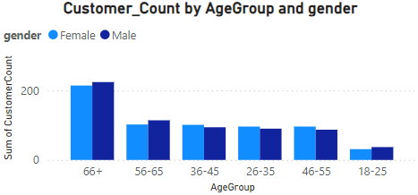
1) CUSTOMER INSIGHTS:
OVERVIEW: It is compared based on Age, Gender, Location, and Customer Count.
Fig 1.1

Slide 7
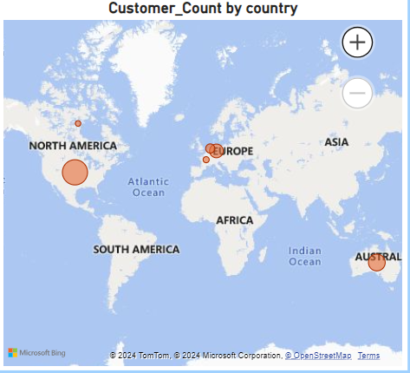
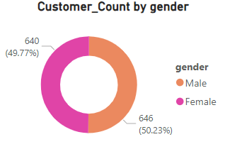
Fig 1.2
Fig 1.3

Slide 8
INSIGHTS:
From above Fig1.1,1.2,1.3, it is cleared that our least customers are at Age 18-25 and high customers are at Age 60+ when compared to other Ages.
Our Top selling countries are America and Australia and least selling country is Canada.
Male and Female customers are equally balanced in many cases.
ACTIONABLE RECOMMENDATIONS:
Refine targeted marketing campaigns based on demographics.
Focus on key demographic groups for personalized promotions.

Slide 9
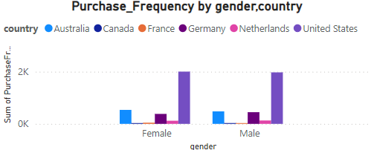
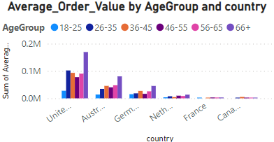
2) PURCHASING BEHAVIOUR:
OVERVIEW: It is compared based on Purchase Frequency, Average order by Age, Gender, Location.
Fig 2.2
Fig 2.1

Slide 10
INSIGHTS:
Purchasing frequency is more in United States, compared to other countries(Fig2.1 & Fig2.2)
More number of purchase is done by people of Age 66+
People of age 56-65 has always maintained balanced irrespective of all Country, Gender etc.
ACTIONABLE RECOMMENDATIONS:
Optimize product launches based on buying patterns.
Bring more promotional strategies to attract youths, so it will increase purchase frequency in Age group between 18 and 25.

Slide 11
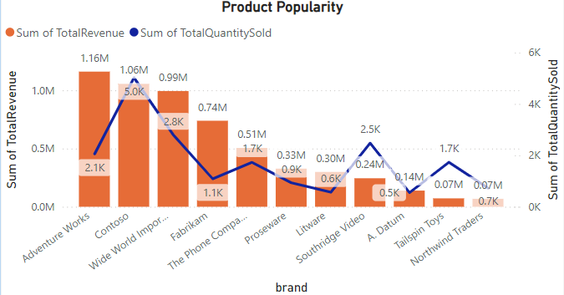
3)PRODUCT PERFORMANCE INSIGHTS:
OVERVIEW: It is compared based on Product Popularity, Profitability brands and Total Revenue based on Category
Fig 3.1

Slide 12
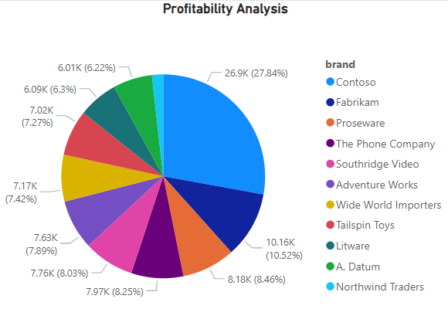
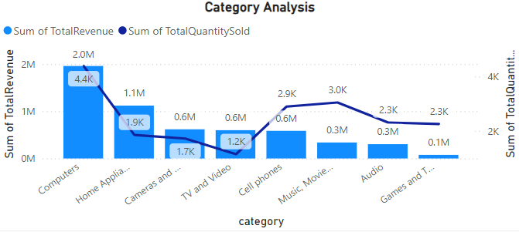
Fig 3.2
Fig 3.3

Slide 13
INSIGHTS:
Contoso Brand is more profit and earning more, which is derived based on past performance of that particular brand
By Category-wise, Computers generate more revenue compared to other category.
Based on Product Popularity, Contoso and Adventure works brands stands tall. Northwind Traders brand need to be improved more.
ACTIONABLE RECOMMENDATIONS:
Discontinue or revamp underperforming products.
Focus marketing efforts on low popularity brands

Slide 14
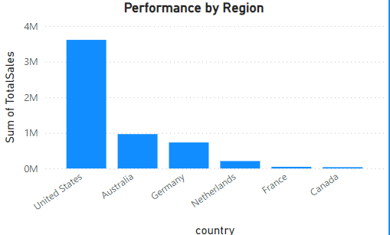
4)STORE OPERATIONS AND PERFORMANCE:
OVERVIEW: Analyze sales performance by Store Location, Operational Efficiency, and Store Size.
Fig 4.1

Slide 15
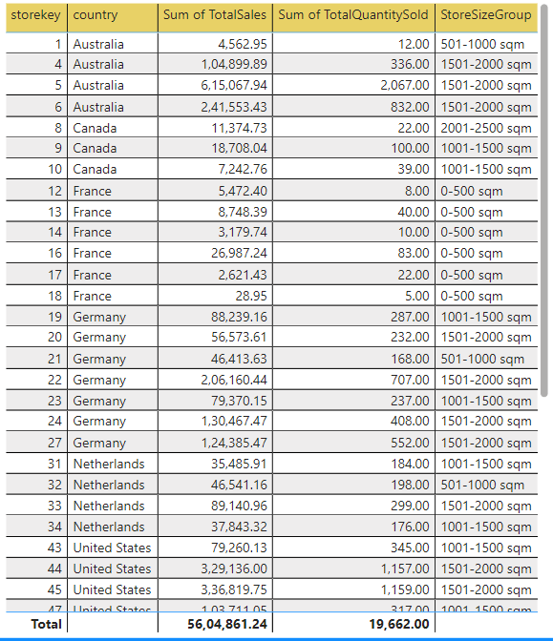
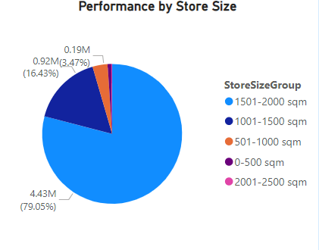
Fig 4.3
Fig 4.2

Slide 16
INSIGHTS:
Stores in United States is one of the top-performing location, when compared to other countries.(Fig 4.1)
StoreSizeGroup from 1500-2000 sqm are performing well.(Fig 4.2 &4.3)
Canada is performing poor in terms of region.
ACTIONABLE RECOMMENDATIONS:
Focus on improving sales in underperforming stores
Offer training or resources to stores with declining performance

Slide 17
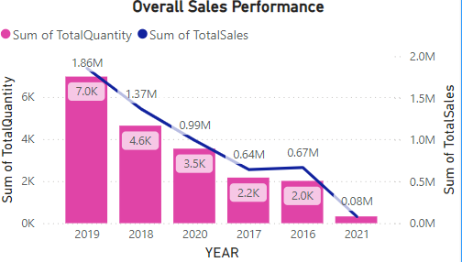
5)SALES BY CURRENCY AND YEAR:
OVERVIEW: Analyze Total sales by Currency and Year
Fig 5.1

Slide 18
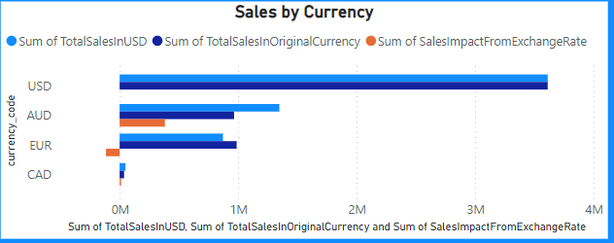
Fig 5.2

Slide 19
INSIGHTS:
Sum of Total Sales is high in 2019 and less in 2021.(Fig 5.1)
Sum of Total Quantity Sold is larger in 2019.
In case of Currency Code, USD remains Tall, followed by AUD.(Fig 5.2)
AUD remains high in sum of sales impact from Exchange Rate.
ACTIONABLE RECOMMENDATIONS:
Adjust pricing strategies based on currency fluctuations.
Hedge against unfavorable exchange rates in key markets
Always compare current year sales with past year performance to give better upcoming year sales.

Slide 20
ACTIONABLE RECOMMENDATIONS OVERALL:
MARKETING STRATEGY: Optimize promotions and improve customer engagement.
SALES FORECASTING: Use purchasing behavior trends and product performance data to better forecast future sales.
PRODUCT DEVELOPMENT: Develop new products based on customer feedback and underperforming product analysis
STORE EXPANSION: Open new stores in high-performing regions and consider closing underperforming locations

Slide 21
CONCLUSIONS:
Position Global Electronics for growth by leveraging these insights to make informed decisions that drive sales and customer satisfaction.
Make decisions based on past feedback and make a free friendly relationship with customers

Slide 22
THANK YOU

